Slide 1

Introduction to Robotics ME 639: Industrial Project Presentation 2
Project Title: AUV Coverage path planning
Team Name: Endsem Nahi Dena
Team Members: Harsh Mandalia, Vignesh, Kshitija Anam
Instructor: Prof. Harish PM
Teaching Assistant: Suraj Borate

Slide 2
Problem Statement:
“ Path planning for an AUV bathymetric survey.”
Industry name: Planys Technologies
Objectives:
Generate an obstacle free path for AUV traversal in given plot shape.
Coverage of maximum area possible through the planning algorithm, at best possible resolution.
1

Slide 3
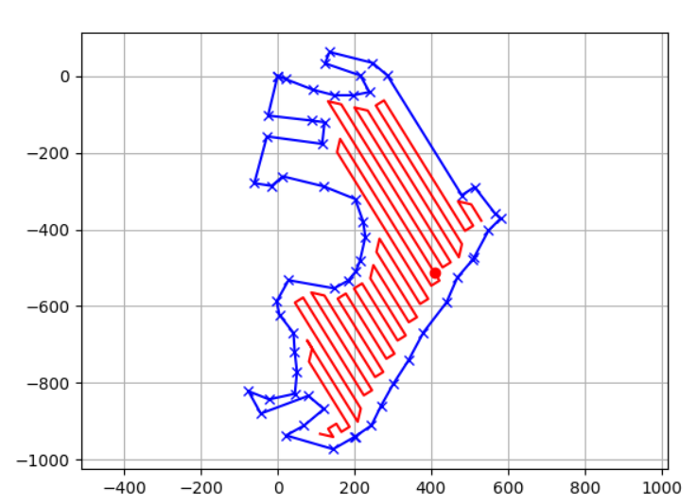
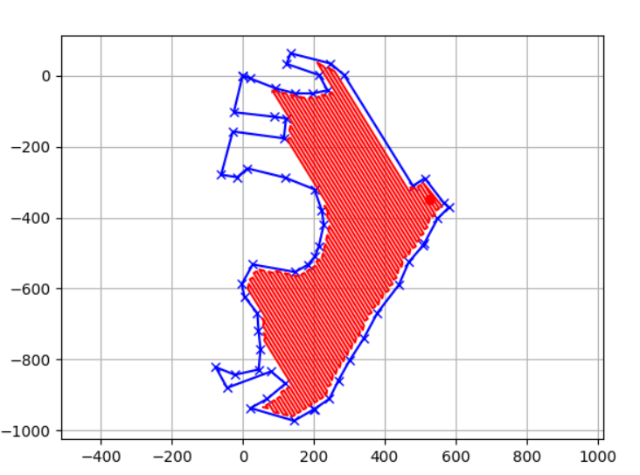
Interim Results: Area 1
Resolution=25m,Coverage area: 83.7%
Resolution=9.3m
2

Slide 4
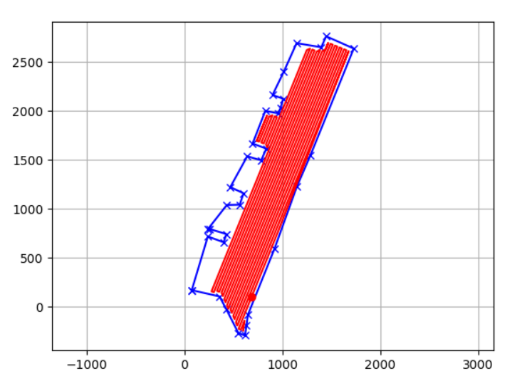
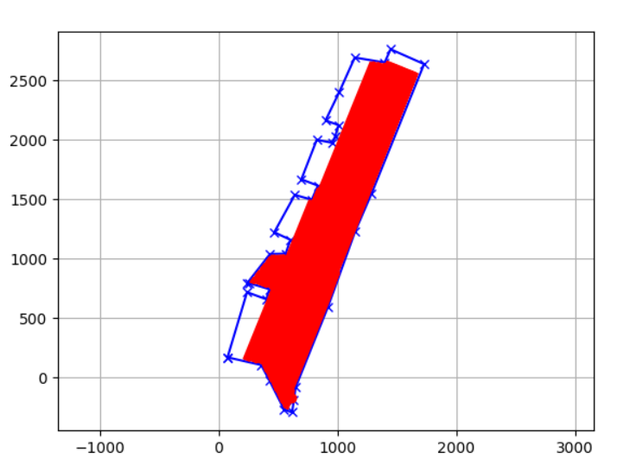
Interim Results: Area 2
Resolution=25m, Coverage area: 81.7%
Resolution=10m
3

Slide 5
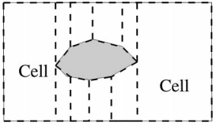
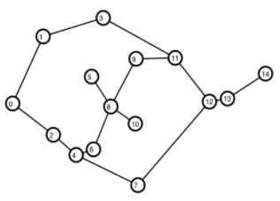

Current Approach:
Zig-Zag Path Coverage [1]
Trapezoidal Cell Decomposition [4]
Shortest Path Cell Traversal [3]
4

Slide 6
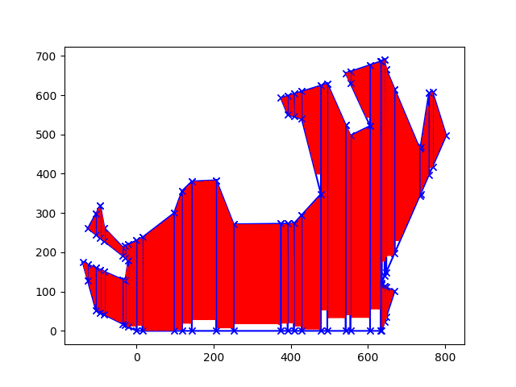
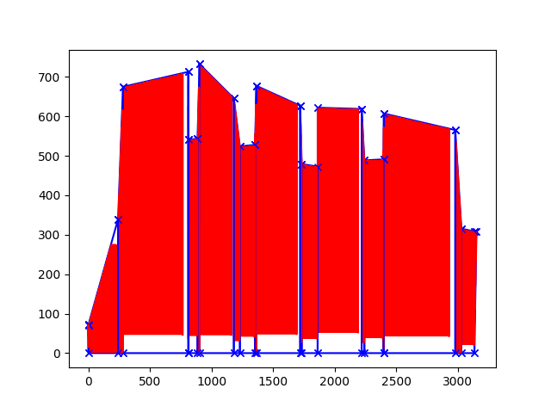
Final Results
Area 1: Coverage Area = 96.47%
Area 2: Coverage Area = 91.47%
5

Slide 7
Improvements Observed over Interim Results:
Resolution improved to 2 m (upper limit) from 10 m in interim results.
For Area 1, Coverage has improved to 96.47% from 83.7%.
For Area 2, Coverage has improved to 91.47% from 81.7%.
GitHUB Link for the code:
https://github.com/harsh-mandalia/iitgn-robotics/tree/Endsem-Nahi-Dena/code
6

Slide 8
Conclusions:
After implementing cell decomposition, we got better resolution and more coverage area.
Limitations and Future Recommendations:
Incomplete coverage of crevice spaces at better resolution.
Cell traversal needs further optimisation for live obstacle avoidance.
7

Slide 9
Deliverables Checklist:
Sr. No. | Deliverables | Source
1 | A brief explanation of the concept (including type of robot, number of links and joints, and other such details) | GitHub
2 | Codes incorporating the solution | GitHub
3 | Figures/drawings/sketches showing the concept | Slide 4
4 | Representative plots/or other representative results from the codes | Slide 5
5 | Explanation of the solution and the results | Slide 6
6 | Statement about limitations and future recommendations | Slide 7
8

Slide 10
References:
Sakai, A. (n.d.). Python Robotics. Pythonrobotics. Retrieved November 2, 2021, from https://atsushisakai.github.io/PythonRobotics/.
Janchiv, A., Batsaikhan, D., Kim, B., Lee, W. G., & Lee, S. G. (2013). Time-efficient and complete coverage path planning based on flow networks for multi-robots. International Journal of Control, Automation and Systems, 11(2), 369-376.
Kindsonthegenius. (2021, January 23). Solving the travelling salesman problem (TSP) with python. Data Science Tutorials. Retrieved November 17, 2021, from https://www.kindsonthegenius.com/data-science/solving-the-travelling-salesman-problem-tsp-with-python/.
G. Chen, Y. Shen, X. Duan, J. Wan, T. Yan and B. He, "Coverage Path Planning Based on Improved Exact Cellular Decomposition Method in Ocean Survey," Global Oceans 2020: Singapore – U.S. Gulf Coast, 2020, pp. 1-4, doi: 10.1109/IEEECONF38699.2020.9388979.
9

Slide 11
Thank You

